Slide 1
Stirring the false vacuum via interacting quantized bubbles on a 5564-qubit quantum annealer
Jaka Vodeb¹, Jean-Yves Desaules^{2,3}, Andrew Hallam³, Andrea Rava^{1,4}, Gregor Humar^{5,6},
Dennis Willsch¹, Fengping Jin¹, Madita Willsch^{1,7}, Kristel Michielsen^{1,4,7} and Zlatko Papić³
1 Jülich Supercomputing Centre, Institute for Advanced Simulation, Forschungszentrum Jülich, 52425 Jülich, Germany
2 Institute of Science and Technology Austria (ISTA), Am Campus 1, 3400 Klosterneuburg, Austria
3 School of Physics and Astronomy, University of Leeds, Leeds LS2 9JT, UK
4 RWTH Aachen University, 52056 Aachen, Germany
5 Department of Complex Matter, Jožef Stefan Institute, Jamova 39, 1000 Ljubljana, Slovenia
6 Department of Physics, Faculty for Mathematics and Physics, Jadranska 19, University of Ljubljana, 1000 Ljubljana, Slovenia
7 AIDAS, 52425 Jülich, Germany
Krvavec, December 16, 2024
arXiv:2406.14718, accepted in Nature Physics

Slide 2
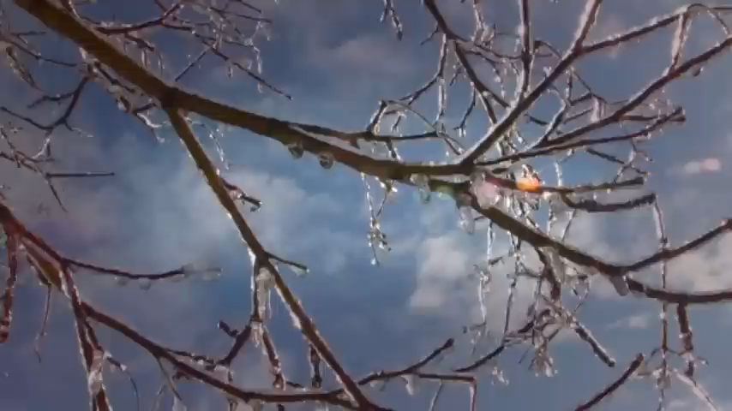

Slide 3
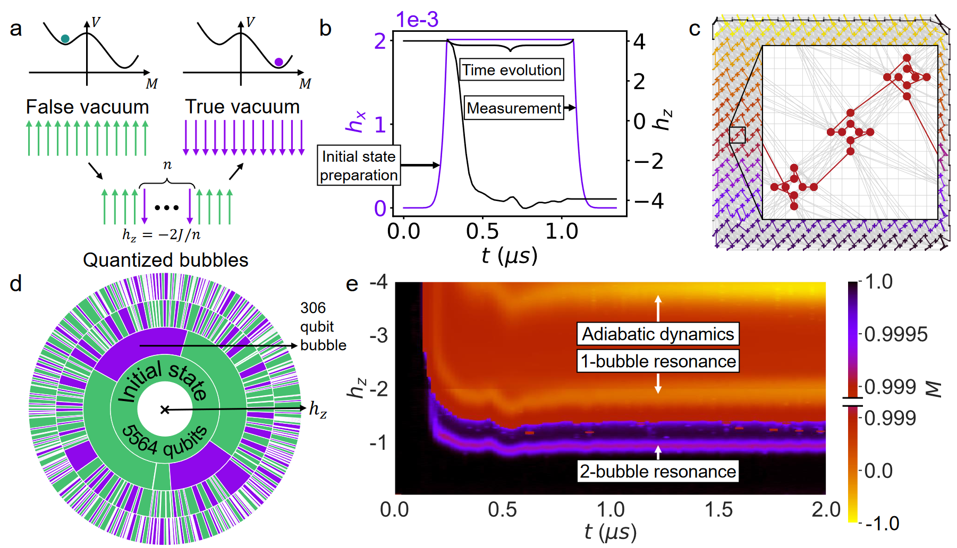
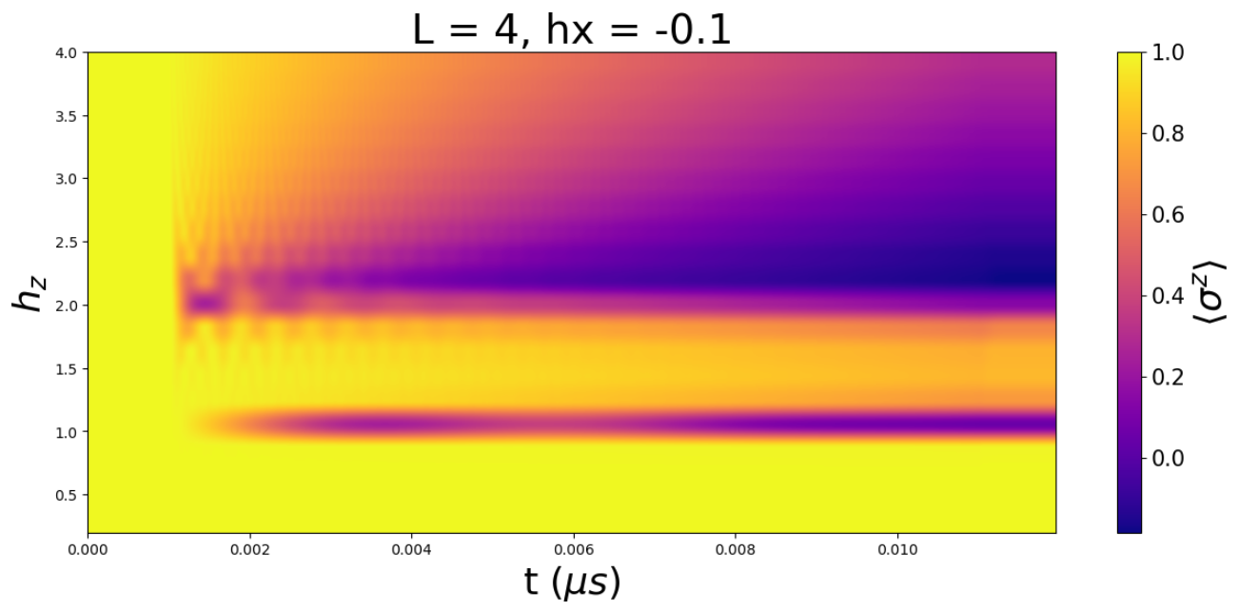


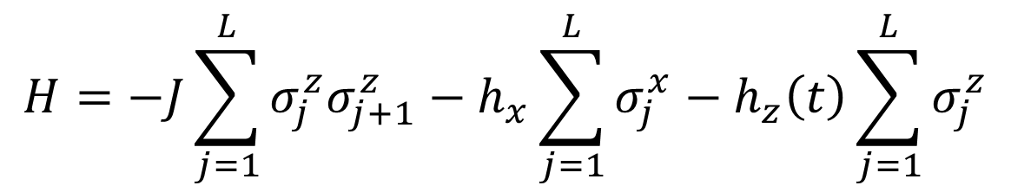






$$H=−J\sum_{j=1}^{L}{σ_{j}^{z}σ_{j+1}^{z}}−h_{x}\sum_{j=1}^{L}{σ_{j}^{x}}−h_{z}\left(t\right)\sum_{j=1}^{L}{σ_{j}^{z}}$$
$$4$$
$$h_{z} magnitude$$
$$M$$
$$2$$
$$1$$
$$h_{z}$$
$$0$$
$$t$$

Slide 4
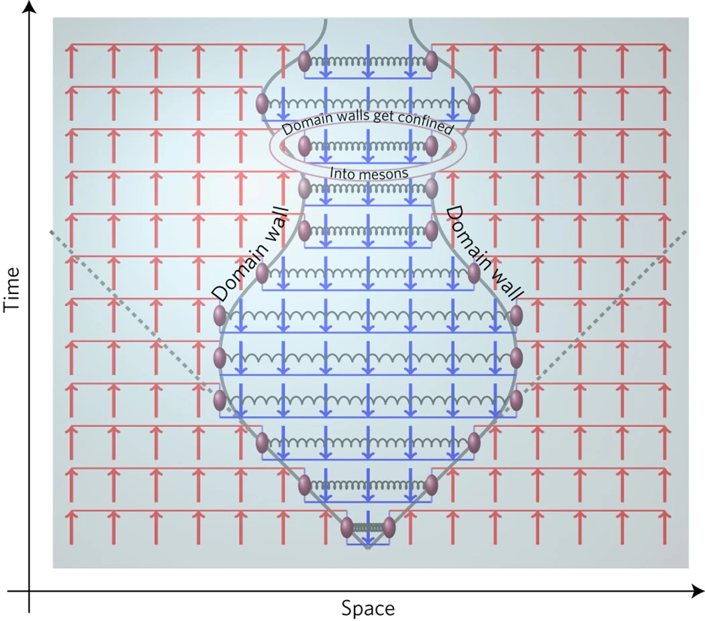
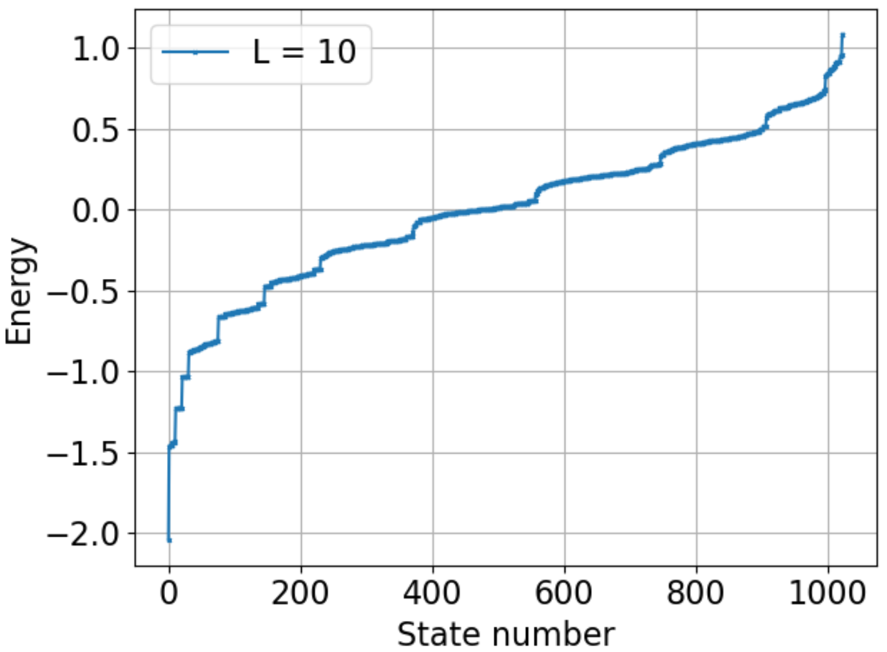
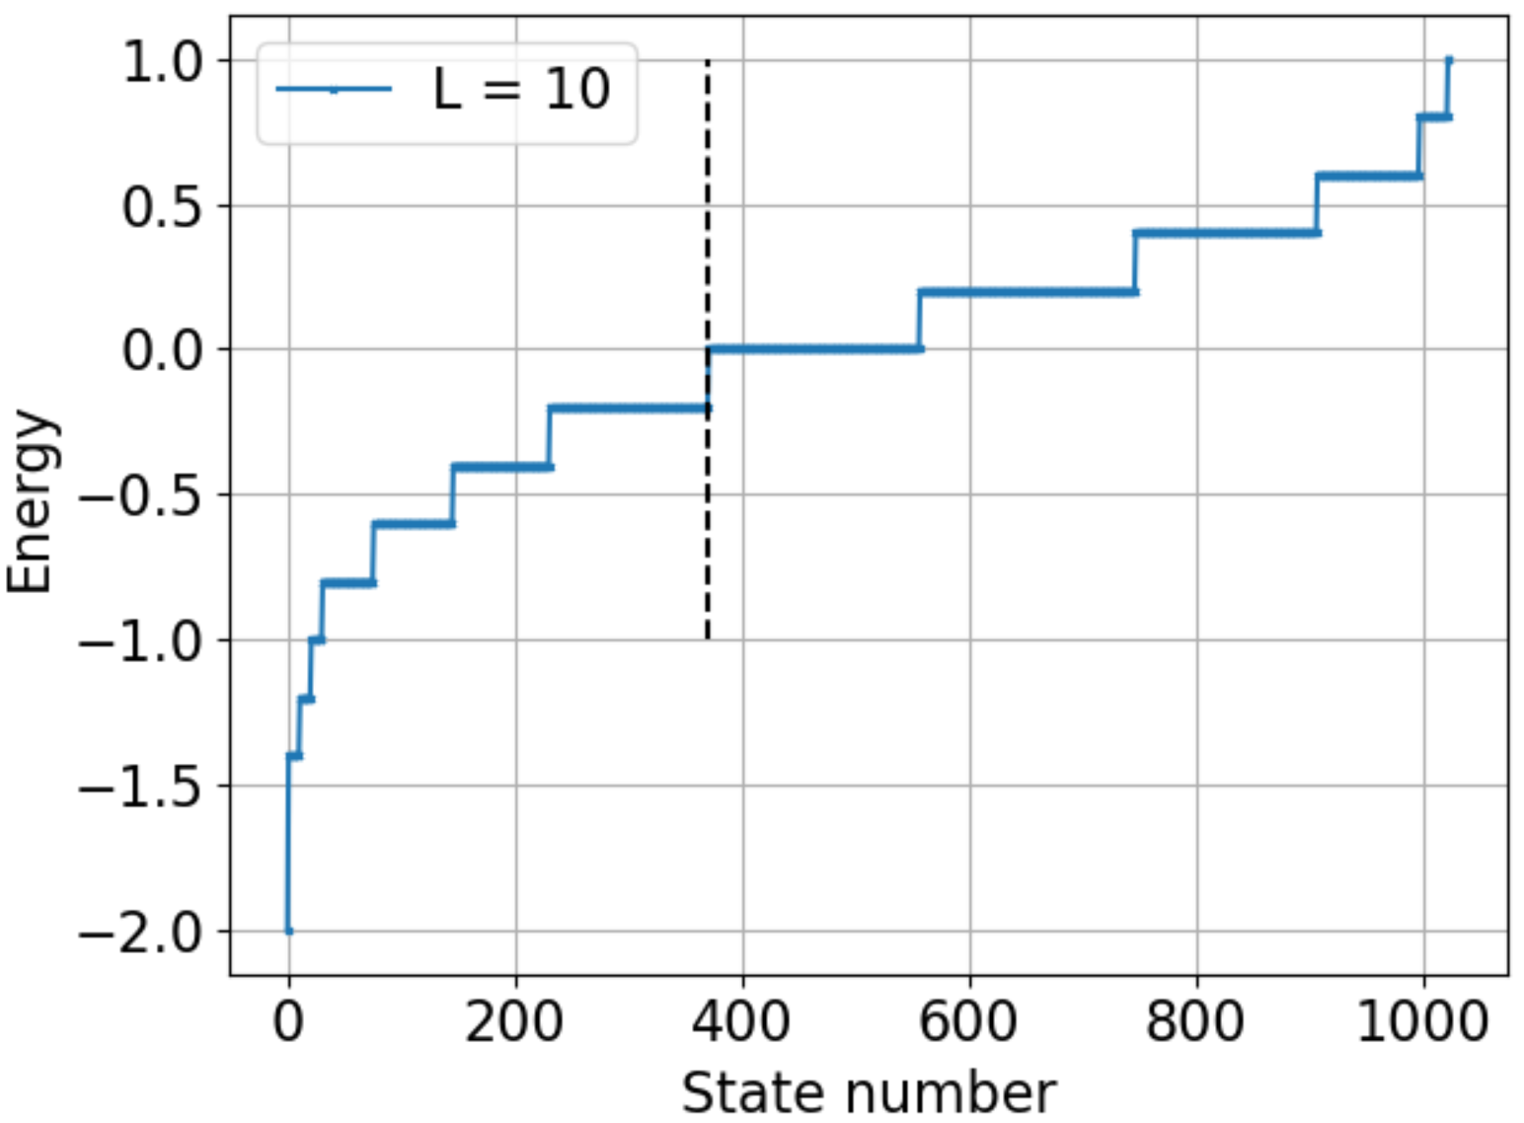
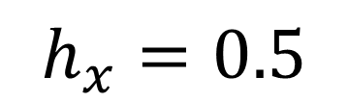
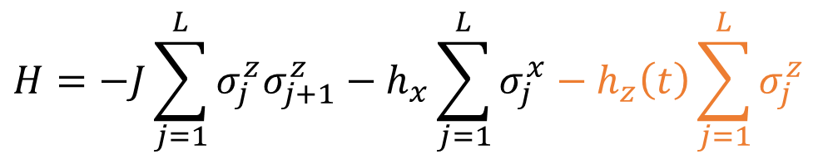


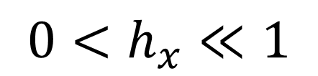
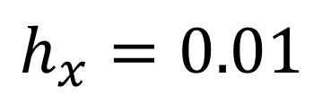
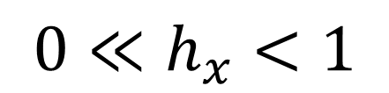

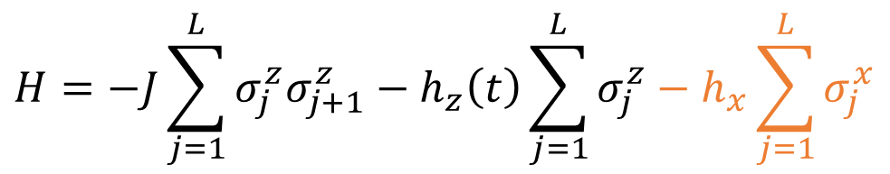


$$0≪h_{x}<1$$
$$0<h_{x}≪1$$
$$H=−J\sum_{j=1}^{L}{σ_{j}^{z}σ_{j+1}^{z}}−h_{x}\sum_{j=1}^{L}{σ_{j}^{x}}−h_{z}\left(t\right)\sum_{j=1}^{L}{σ_{j}^{z}}$$
$$H=−J\sum_{j=1}^{L}{σ_{j}^{z}σ_{j+1}^{z}}−h_{z}\left(t\right)\sum_{j=1}^{L}{σ_{j}^{z}}−h_{x}\sum_{j=1}^{L}{σ_{j}^{x}}$$
$$h_{z}=1$$
$$h_{z}=1$$
$$h_{x}=0.5$$
$$h_{x}=0.01$$
$$Kormos et al., Nature Physics 2017;$$
$$Lagnese et al., PRB 2021$$
$$Our result$$

Slide 5
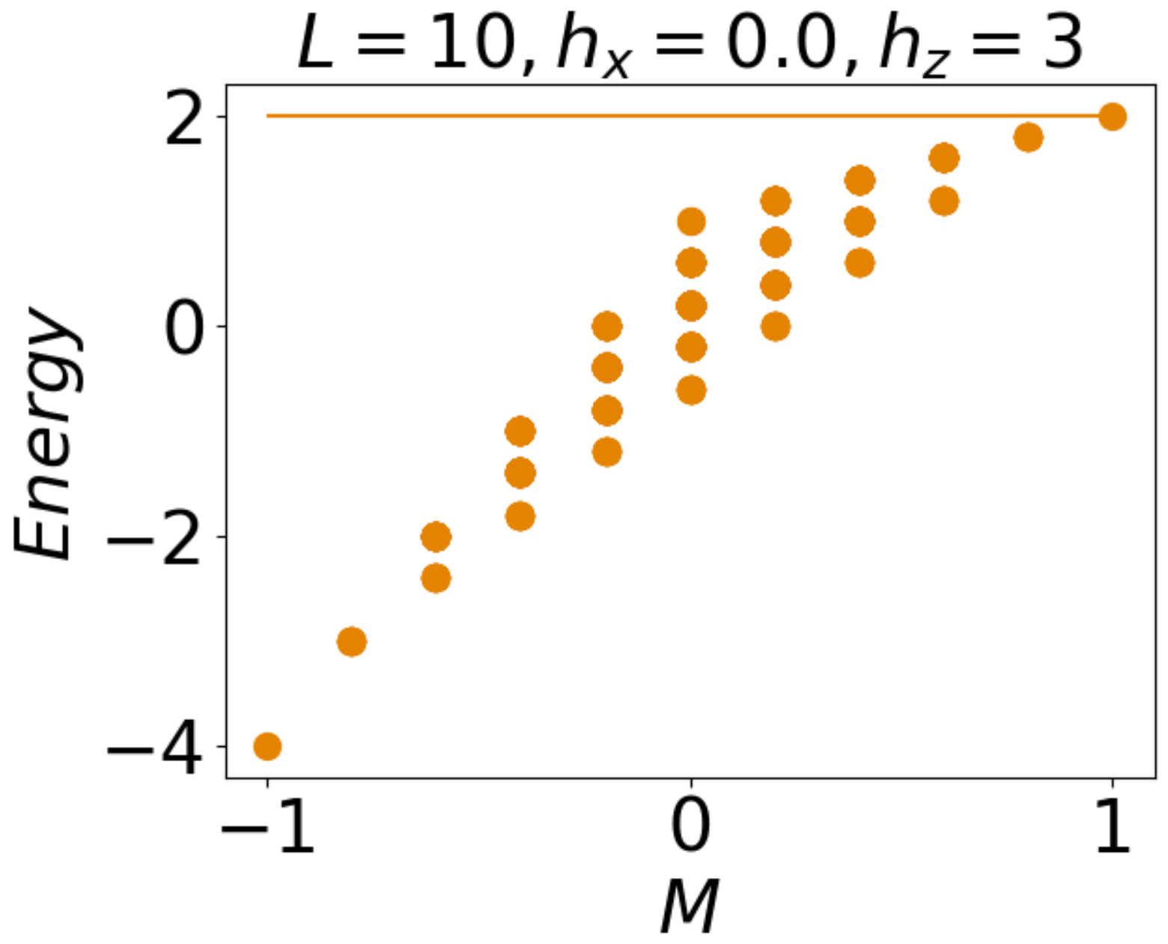
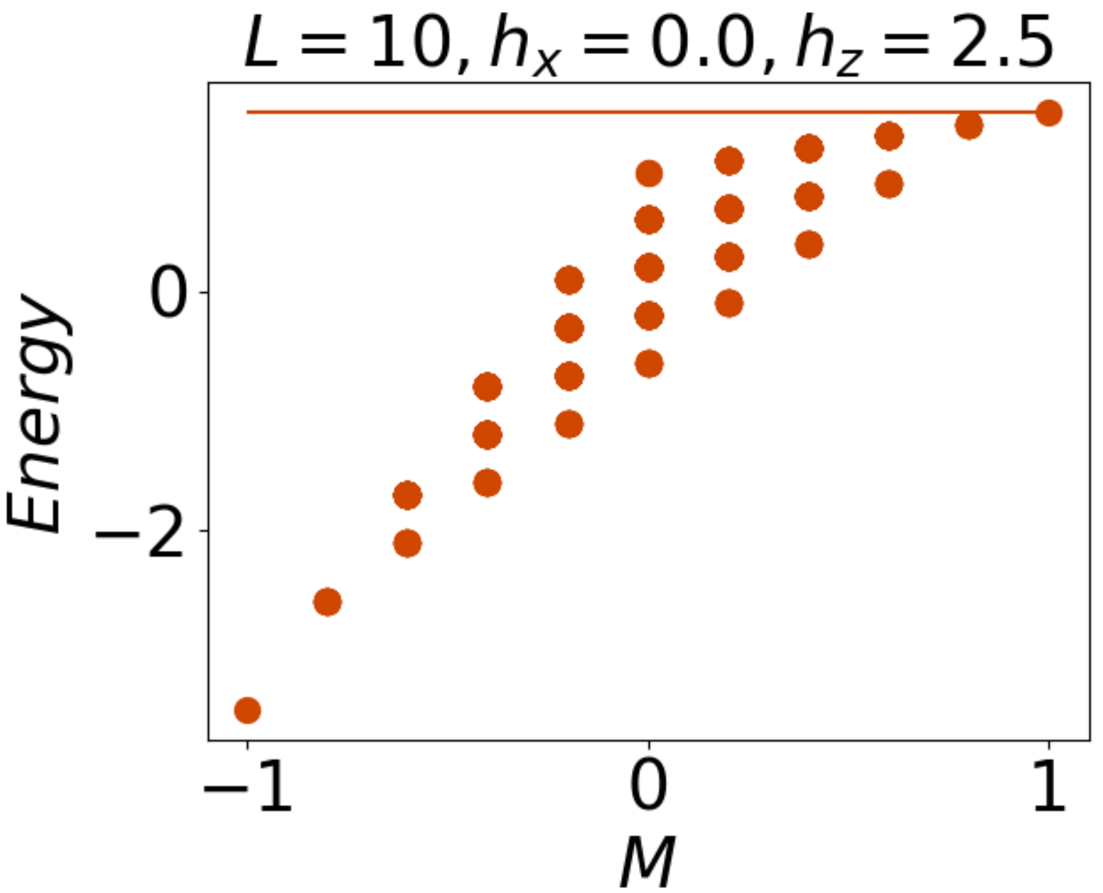
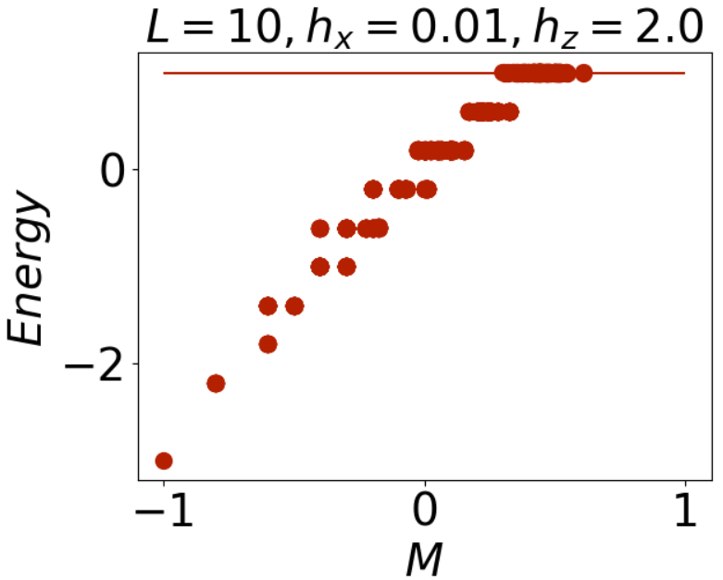
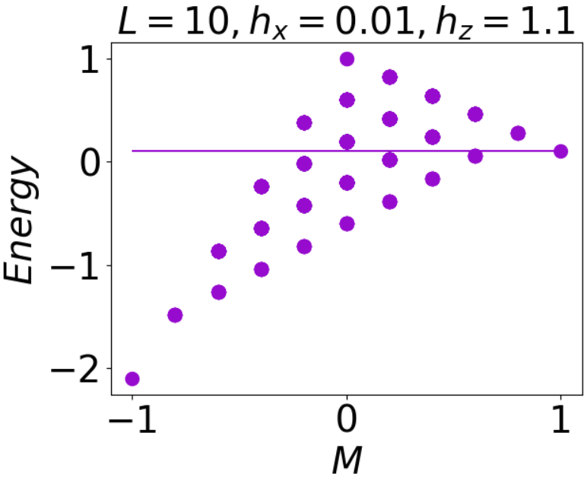
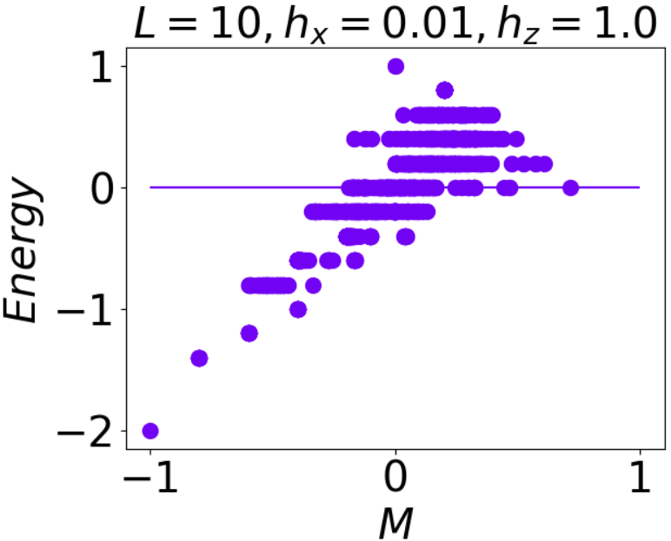
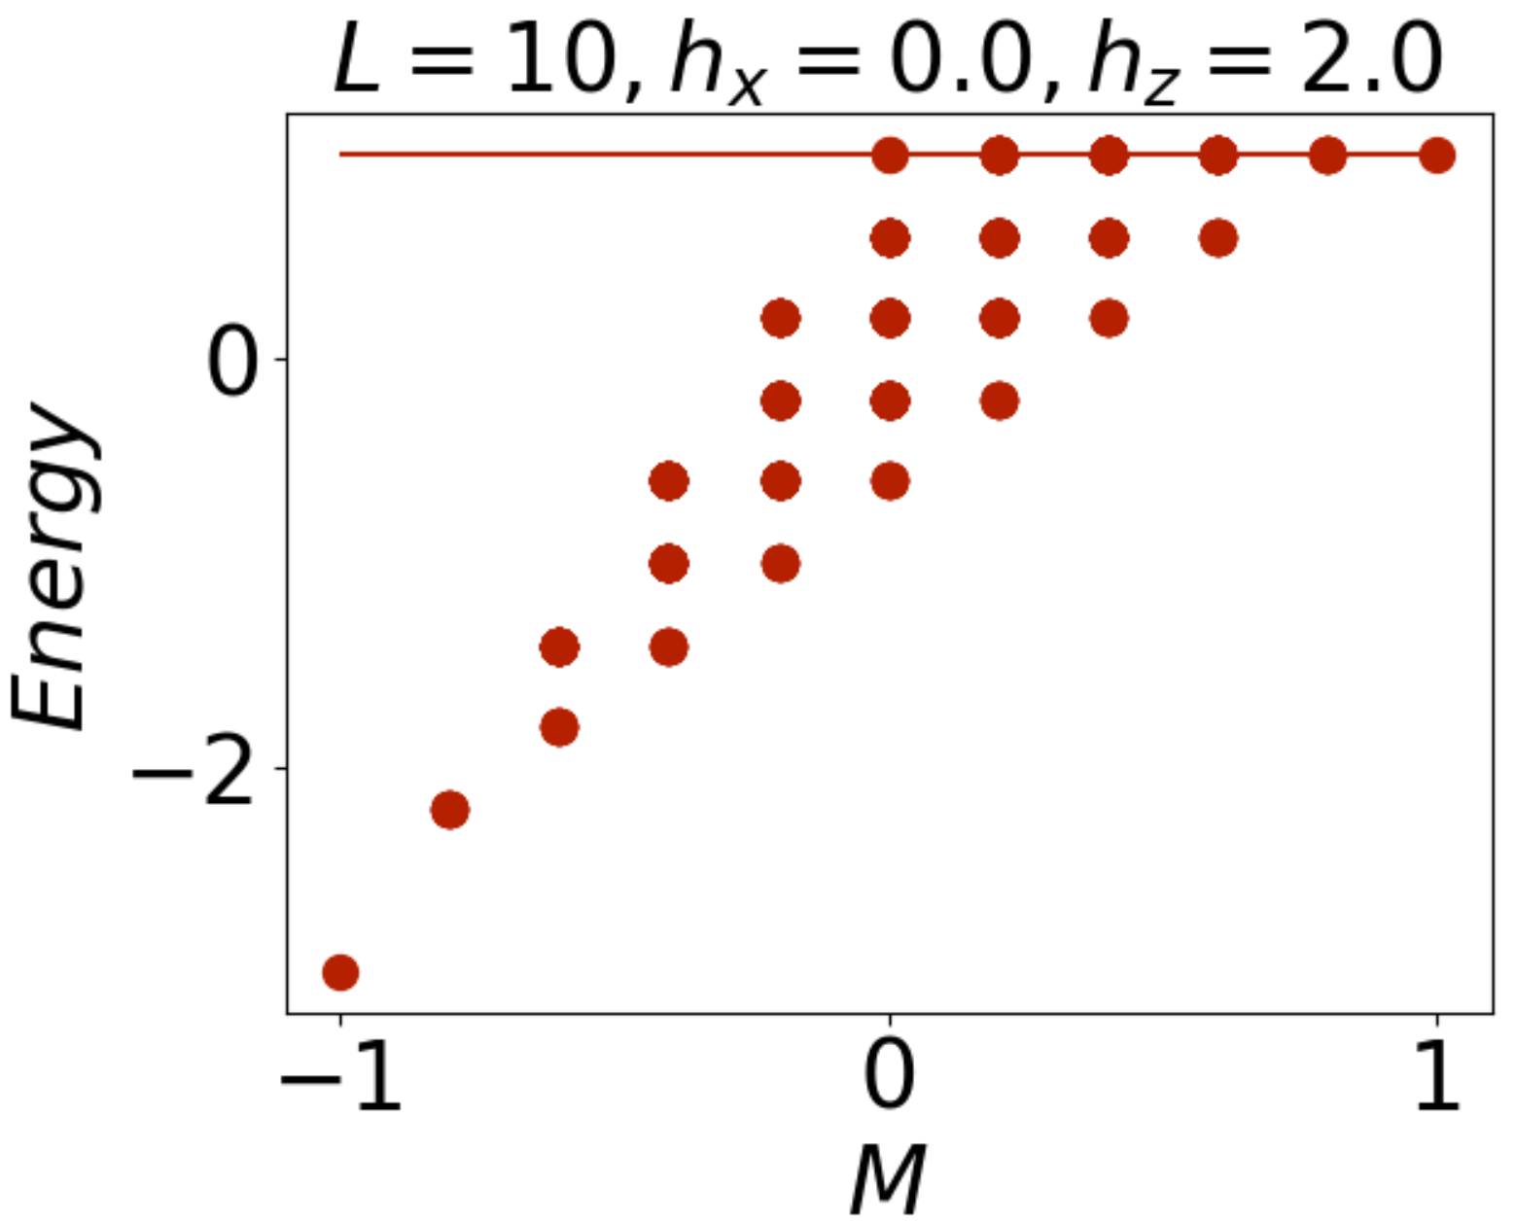
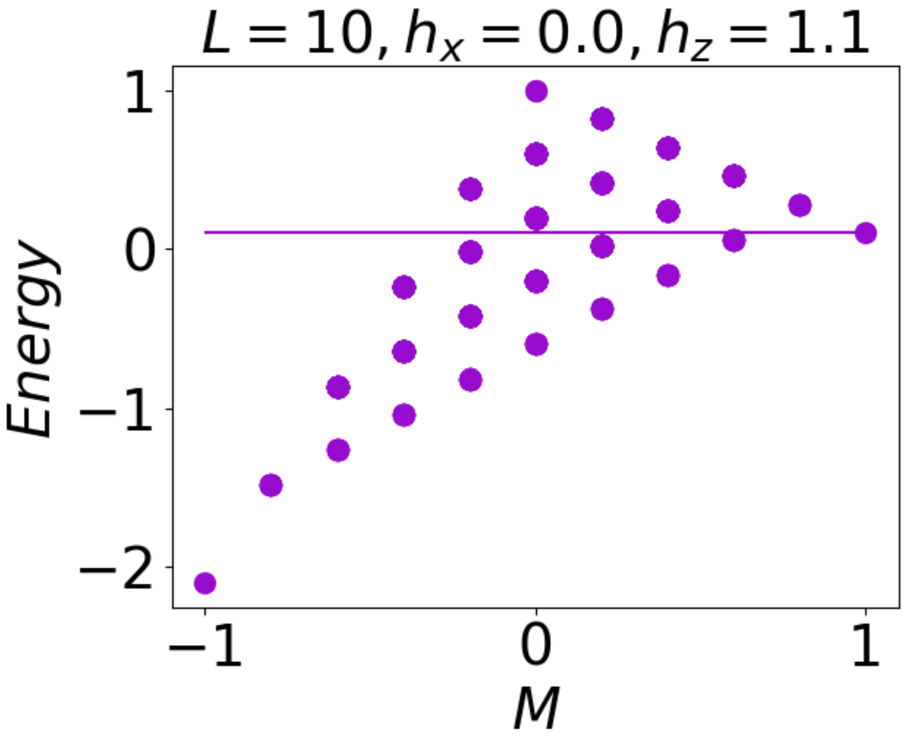
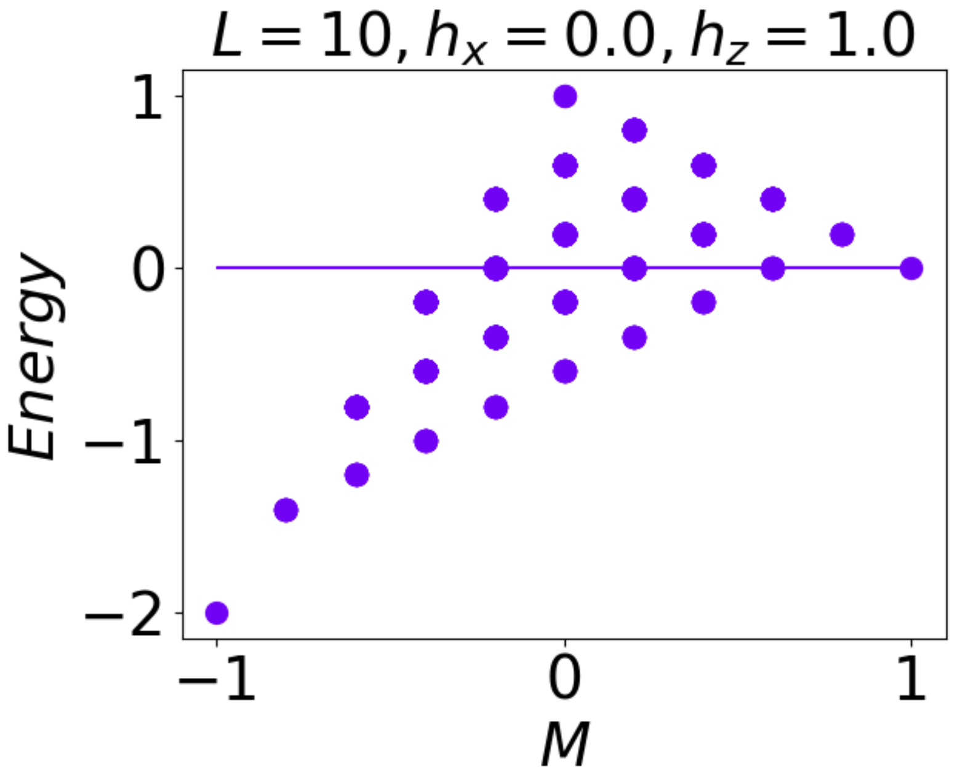





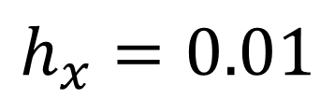

$$h_{z}=3$$
$$h_{z}=2.5$$
$$h_{z}=1$$
$$h_{x}=0.01$$
$$h_{z}=2$$
$$h_{z}=1.1$$
$$h_{z}=1$$

Slide 6
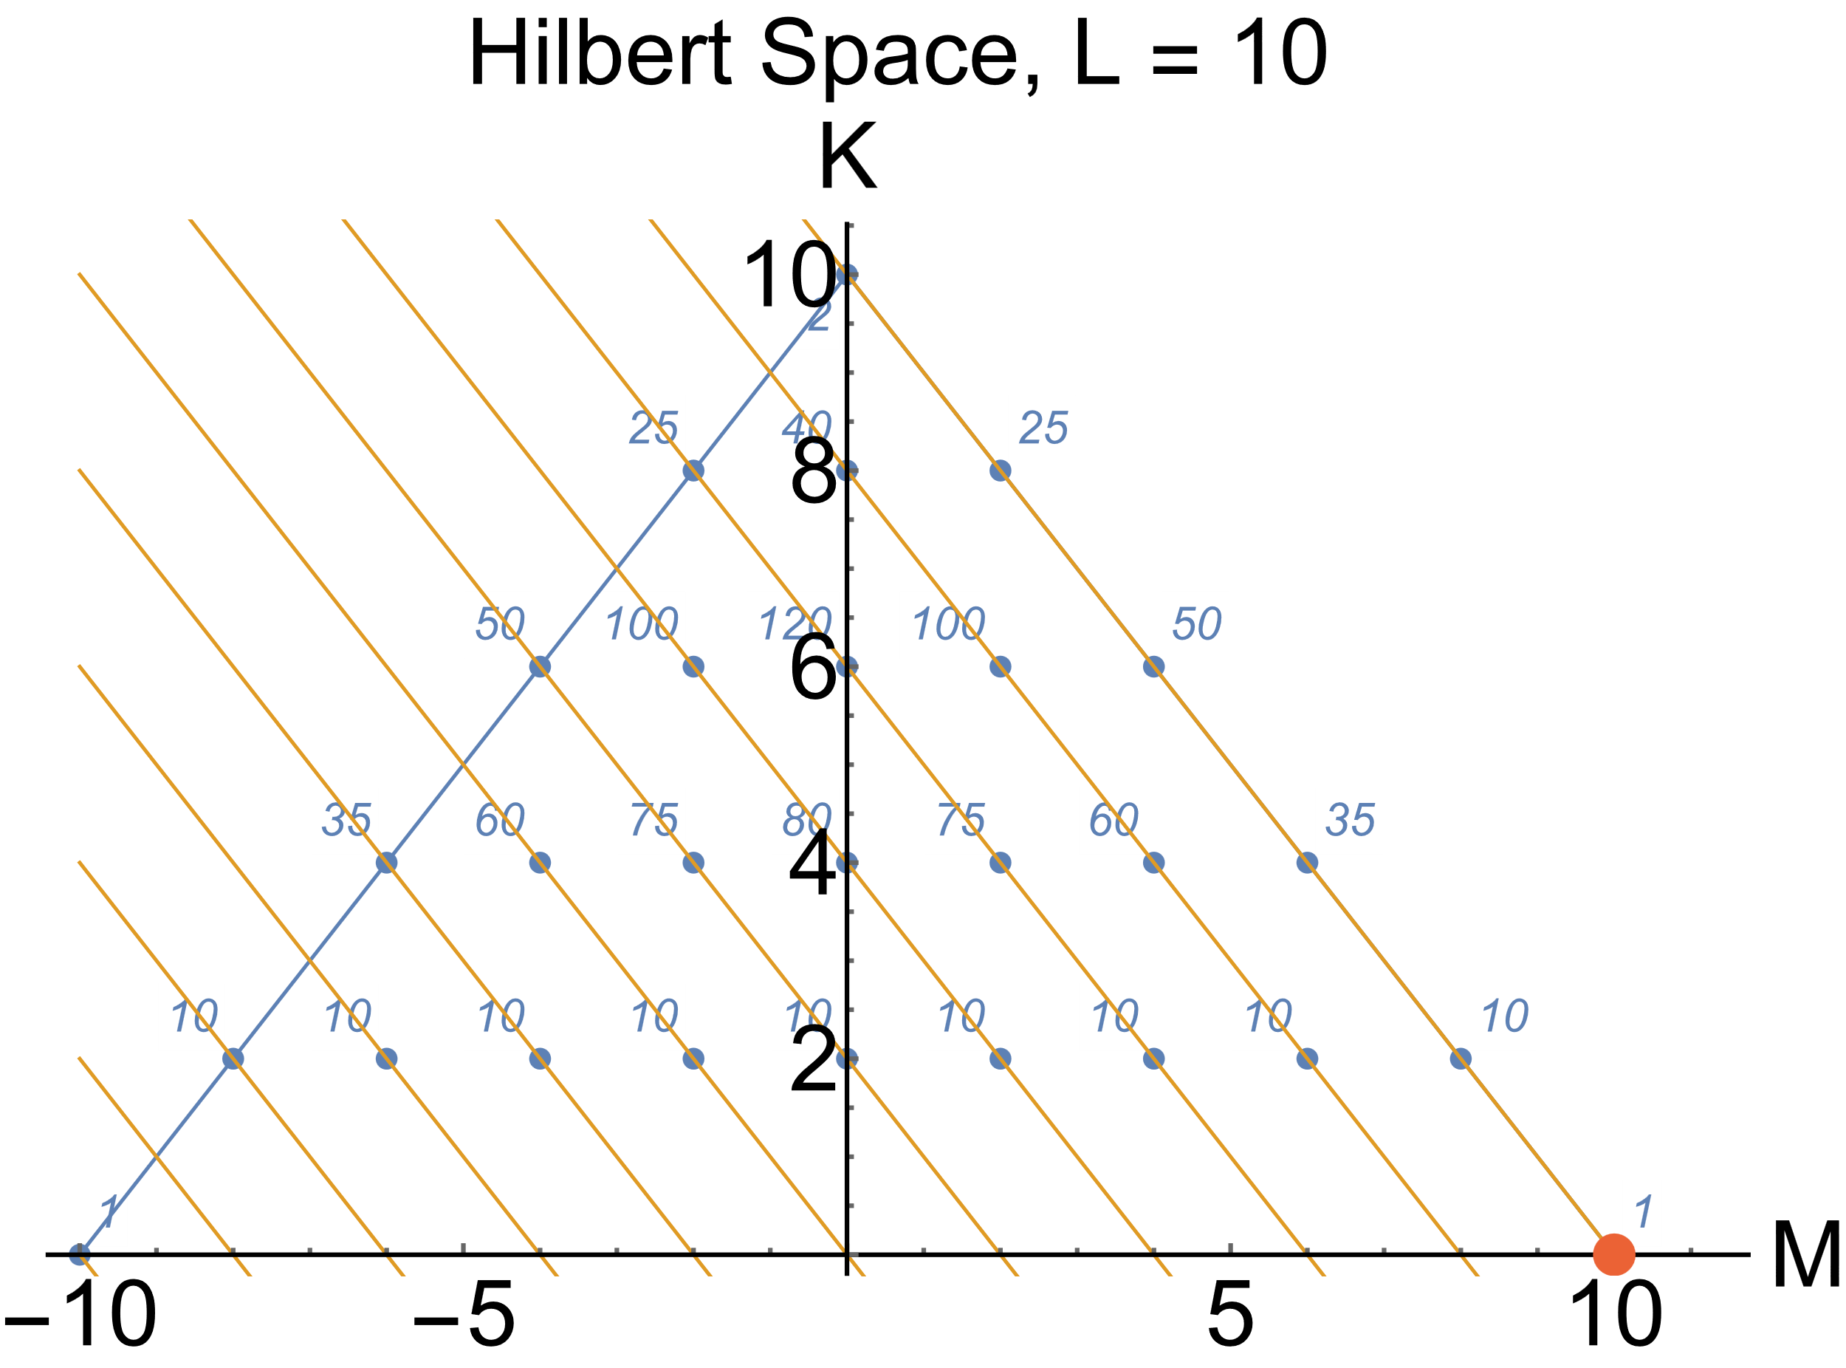
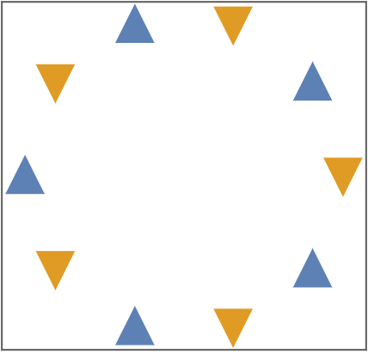
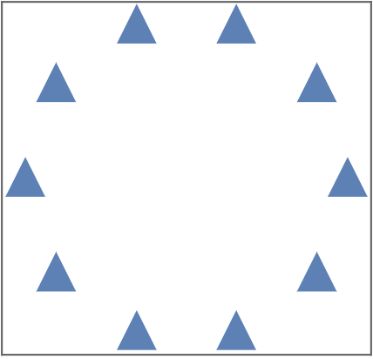


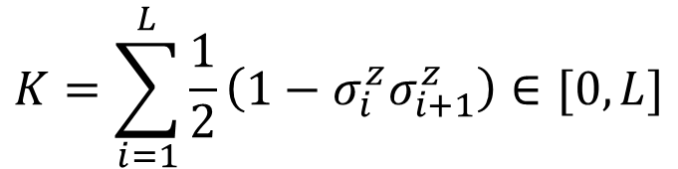
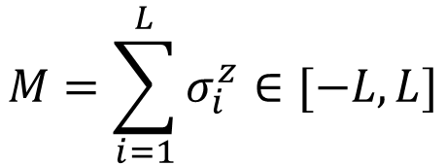
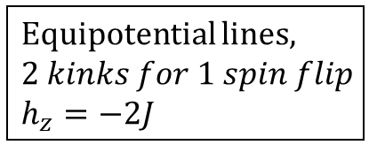
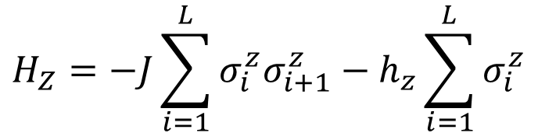
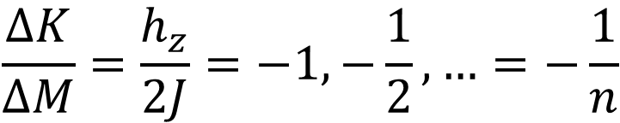
1D Extended transverse field Ising model– Hilbert space
$$H_{Z}=−J\sum_{i=1}^{L}{σ_{i}^{z}σ_{i+1}^{z}}−h_{z}\sum_{i=1}^{L}{σ_{i}^{z}}$$
Equipotential lines,
$$2 kinks for 1 spin flip$$
$$h_{z}=−2J$$
$$M=\sum_{i=1}^{L}{σ_{i}^{z}}∈[−L,L]$$
$$K=\sum_{i=1}^{L}{\frac{1}{2}\left(1−σ_{i}^{z}σ_{i+1}^{z}\right)}∈[0,L]$$
Degeneracy
$$H_{Z}=2JK−JL−h_{z}M$$
$$ΔH_{Z}=2JΔK−h_{z}ΔM=0$$
$$\frac{ΔK}{ΔM}=\frac{h_{z}}{2J}=−1,−\frac{1}{2},…=−\frac{1}{n}$$
All spins up state

Slide 7
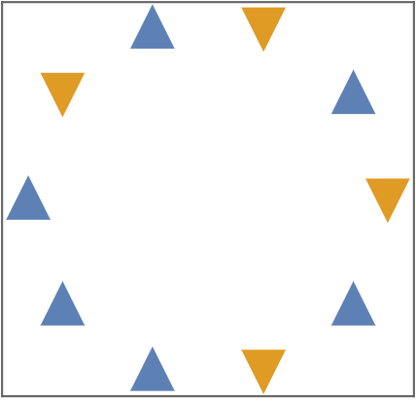
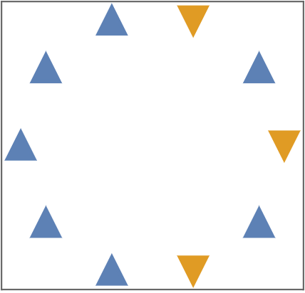
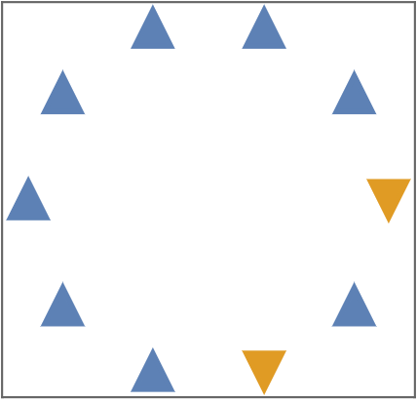
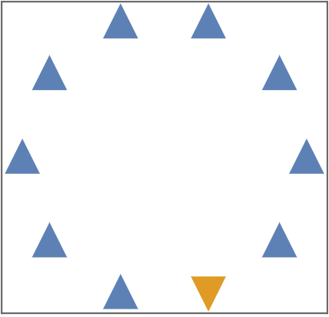




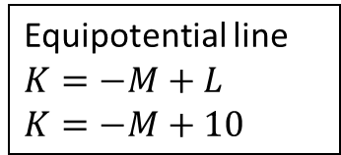


$h_{z}=−2J$resonance, $H_{eff}∝h_{x}$
$M=0$, $K=10$
Equipotential line
$$K=−M+L$$
$$K=−M+10$$
$M=2$, $K=8$
$M=4$, $K=6$
$M=6$, $K=4$
$M=8$, $K=2$
$M=10$, $K=0$

Slide 8
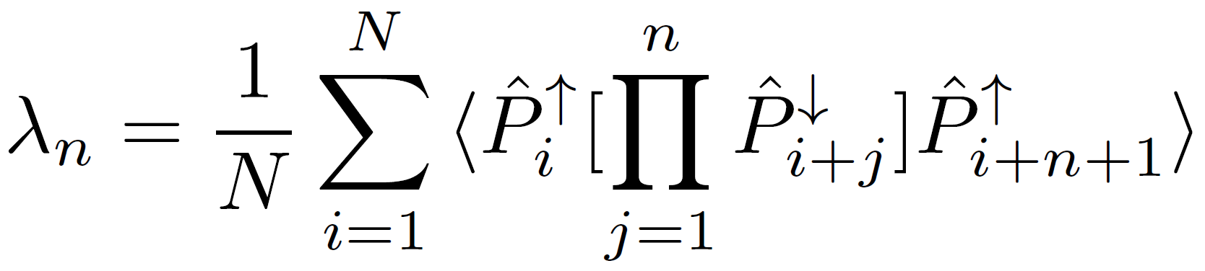
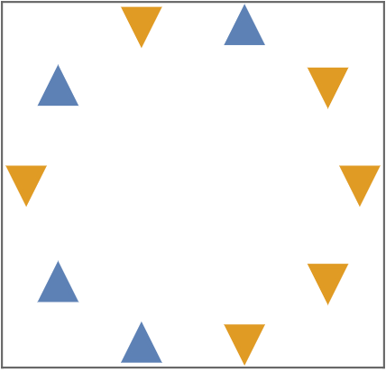
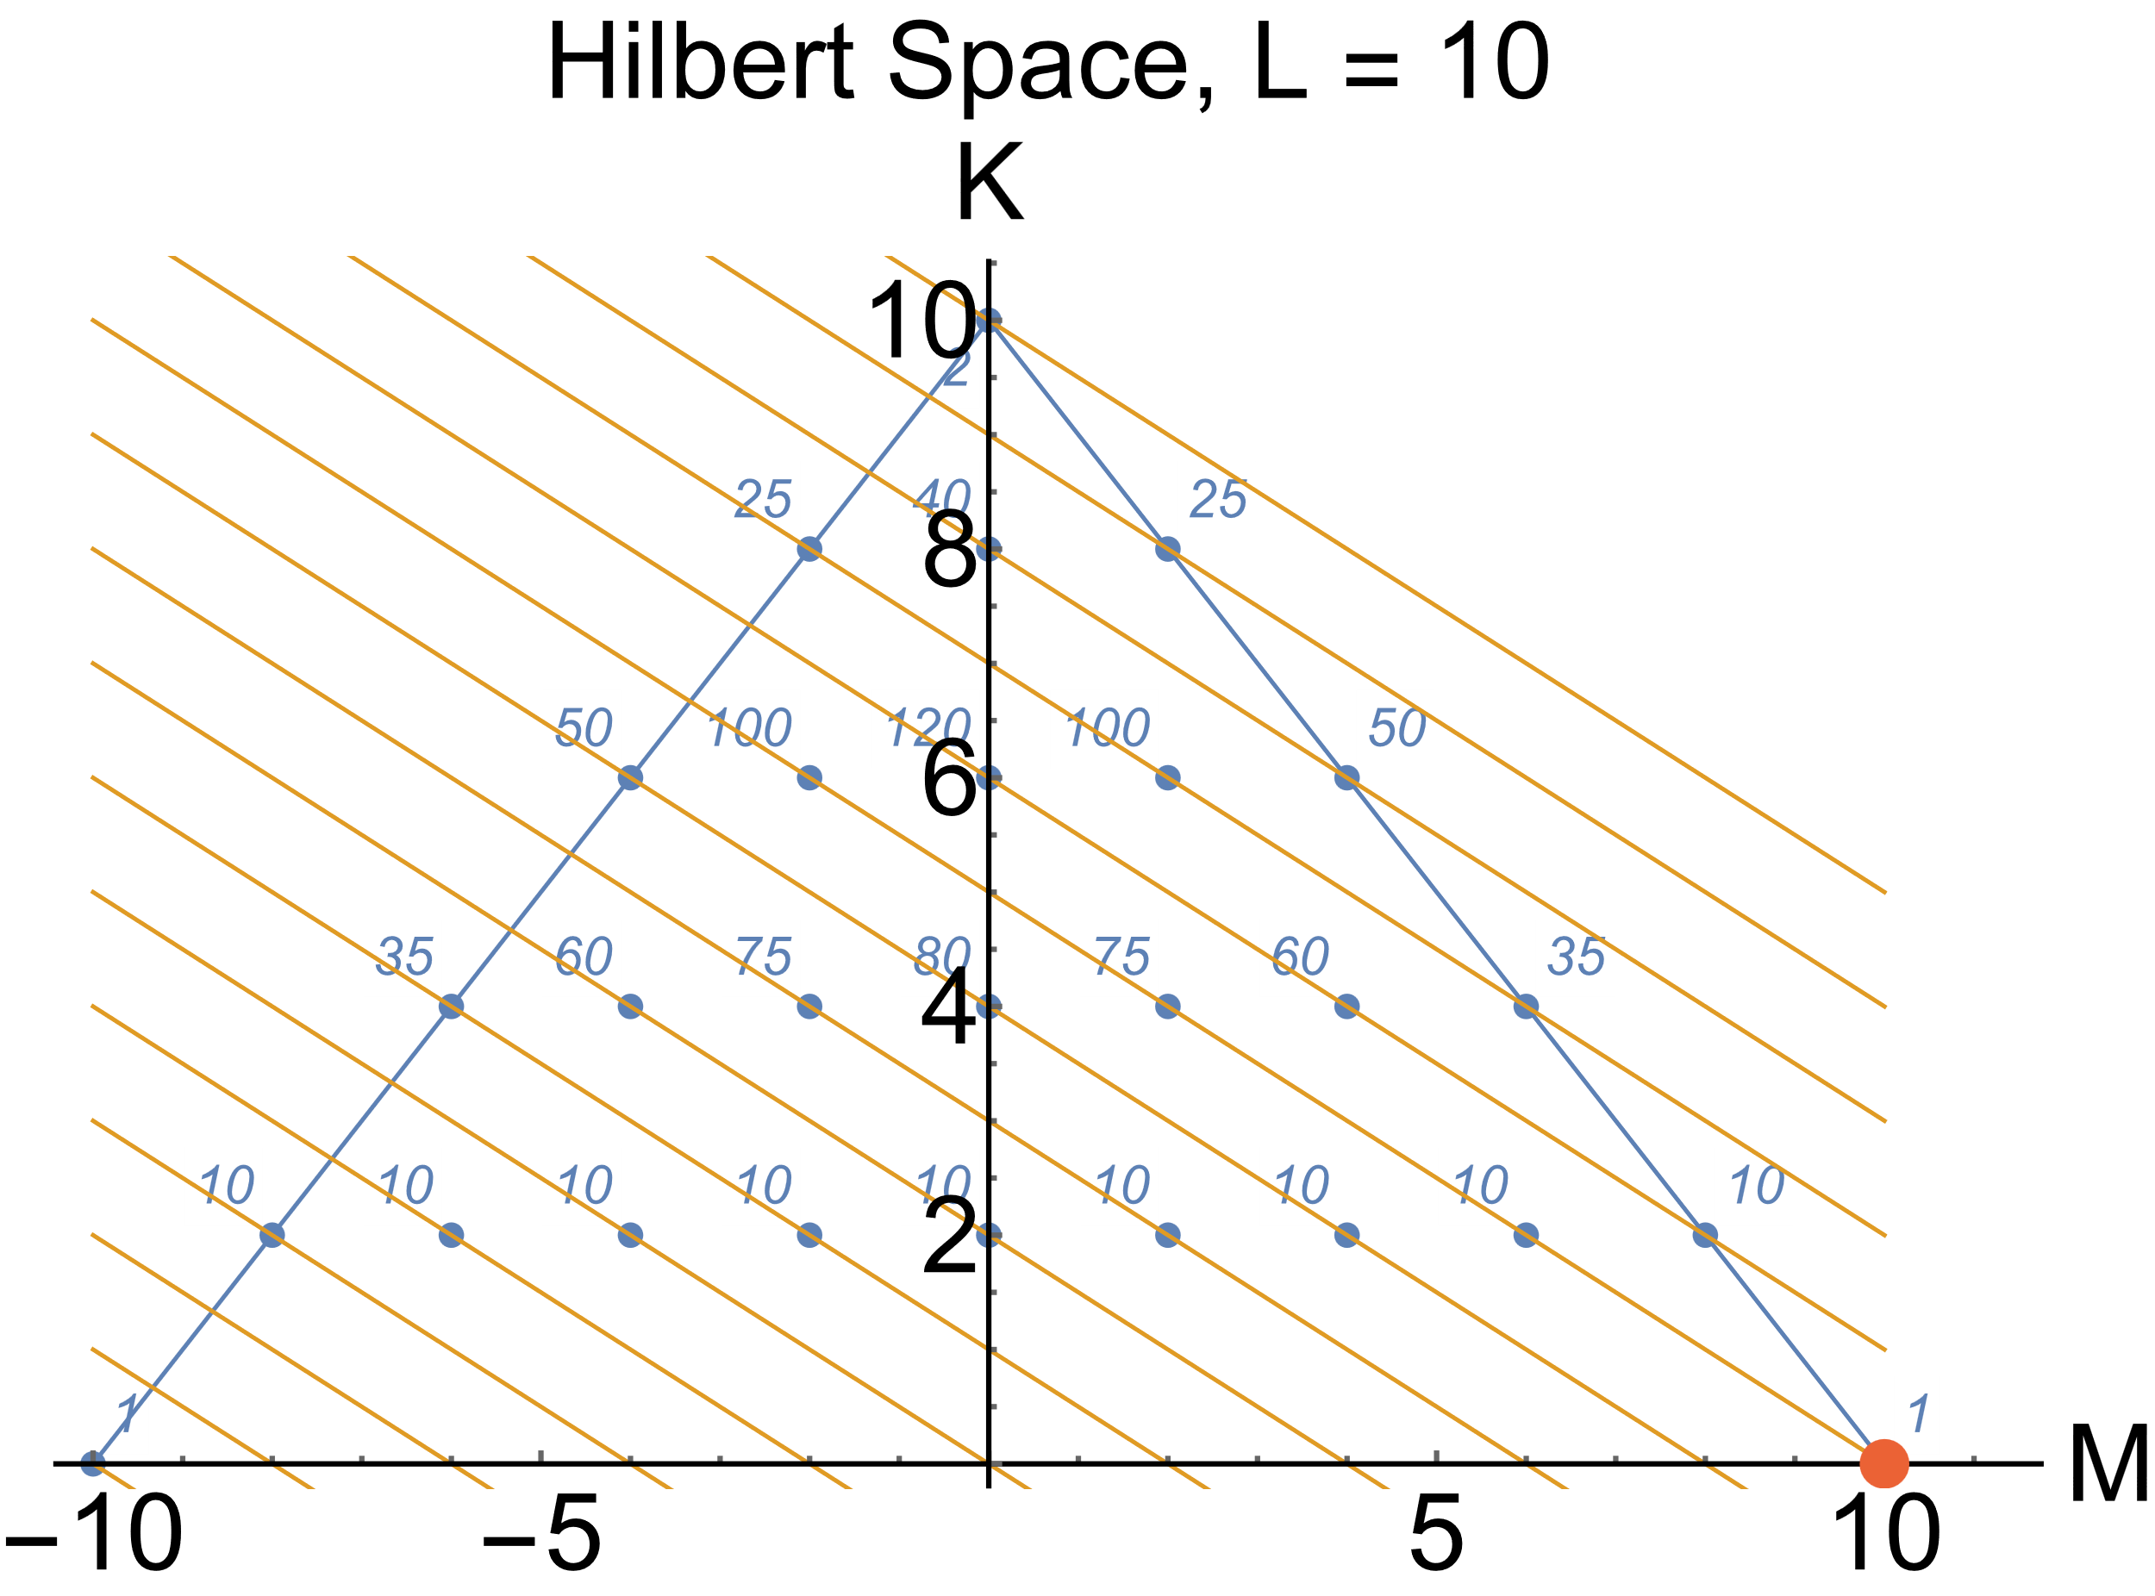
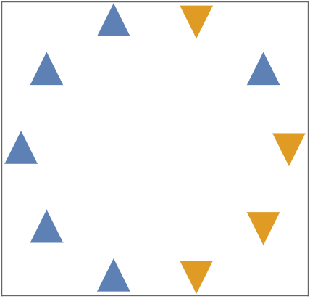
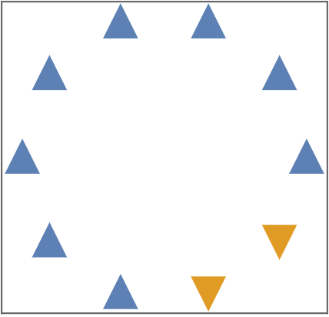


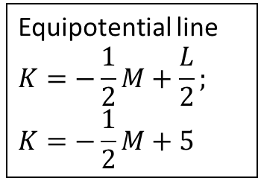


$h_{z}=−J$resonance , $H_{eff}∝h_{x}^{2}$
Equipotential line
$$K=−\frac{1}{2}M+\frac{L}{2};$$
$$K=−\frac{1}{2}M+5$$
$$λ_{1}=2/10,λ_{4}=1/10$$
$$λ_{1}=1/10,λ_{3}=1/10$$
$$λ_{2}=1/10$$
$$λ_{n}=0$$

Slide 9

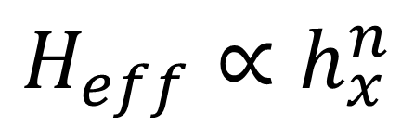
$$h_{z}$$
$$H_{eff}∝h_{x}^{n}$$

Slide 10
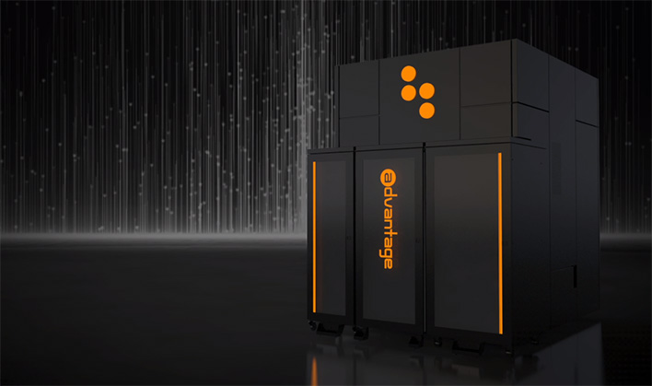
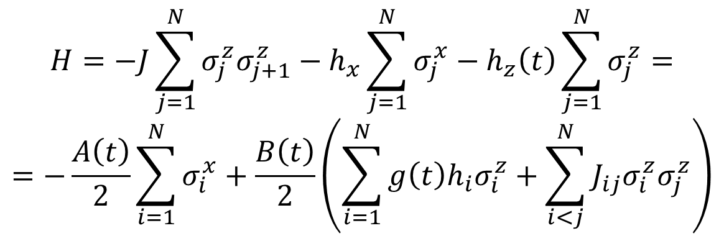
$$H=−J\sum_{j=1}^{N}{σ_{j}^{z}σ_{j+1}^{z}}−h_{x}\sum_{j=1}^{N}{σ_{j}^{x}}−h_{z}\left(t\right)\sum_{j=1}^{N}{σ_{j}^{z}}=$$
$$=−\frac{A\left(t\right)}{2}\sum_{i=1}^{N}{σ_{i}^{x}}+\frac{B\left(t\right)}{2}\left(\sum_{i=1}^{N}{g\left(t\right)h_{i}σ_{i}^{z}}+\sum_{i<j}^{N}{J_{ij}σ_{i}^{z}σ_{j}^{z}}\right)$$
D-Wave Advantage quantum annealer
Embedding of a 5564 spin chain

Slide 11
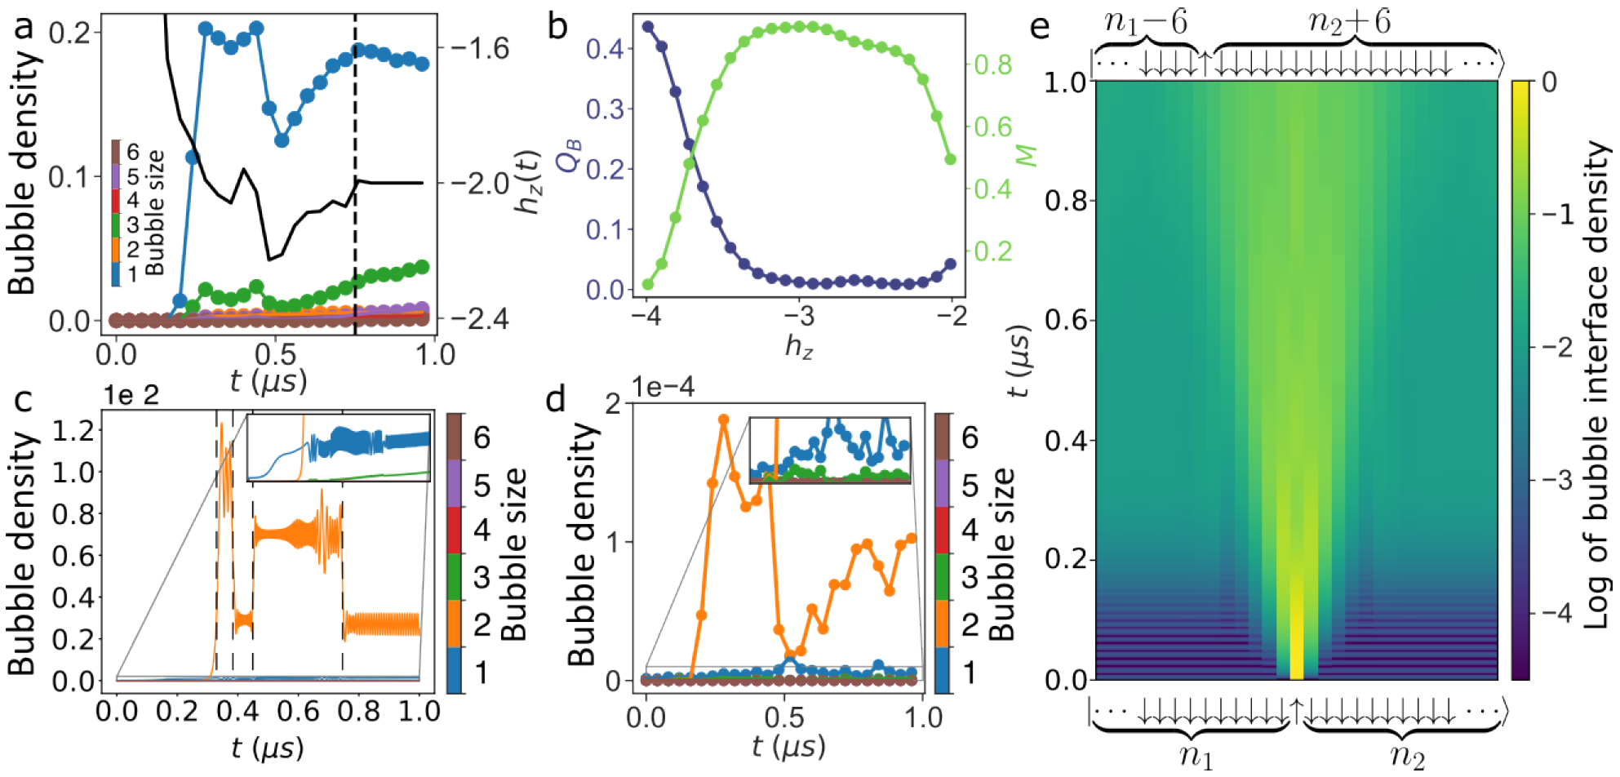
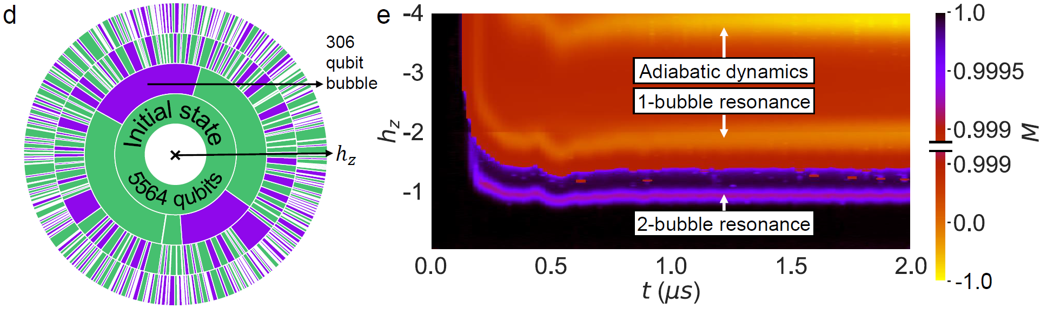
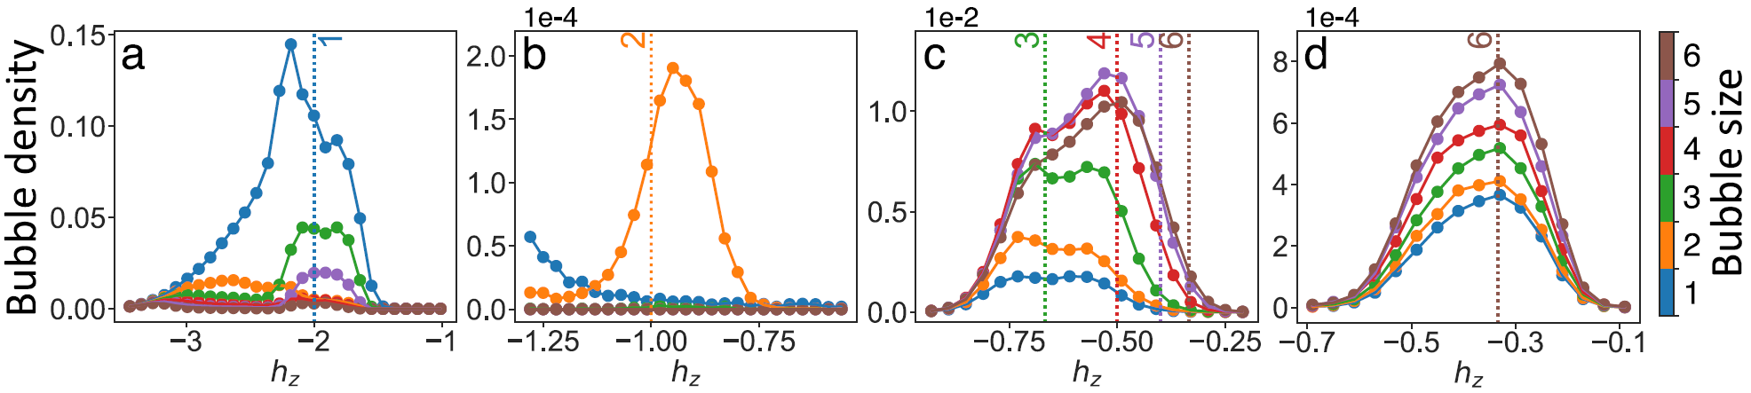






$$h_{z}=−2J/n$$
$$H_{eff}∝h_{x}^{n}$$
$$h_{x}=0.002, t=2μs$$
$$h_{x}=0.002, t=2μs$$
$$h_{x}=0.05, t=1μs$$
$$h_{x}=0.1, t=1μs$$

Slide 12
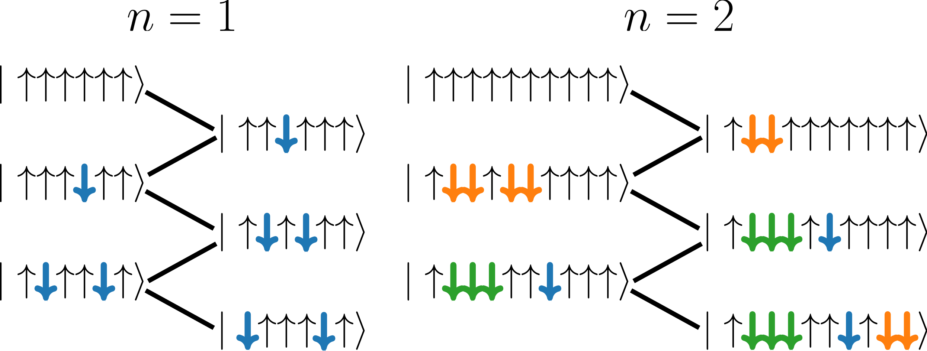




$$n=1, H_{eff}∝h_{x}$$
$$n=2, H_{eff}∝h_{x}^{2}$$
Schrieffer-Wolff transformation

Slide 13



$$MPS numerical emulation$$
$$Quantum annealer$$

Slide 14











$$Quantum annealer$$
$$Quantum annealer$$
Sinha, A., Chanda, T. and Dziarmaga, J., 2021. Nonadiabatic dynamics across a first-order quantum phase transition: Quantized bubble nucleation. Physical Review B, 103(22), p.L220302.
$$MPS numerical emulation$$
$$Quantum annealer$$

Slide 15
False vacuum decay on a square lattice in a quantum annealer

Slide 16










$$False vacuum decay at h_{x}≪1$$
$$E$$
$$?$$
$$h_{z}$$
$$h_{z}$$
$$M$$
$H=h_{x}\sum_{i}{σ_{i}^{x}}+h_{z}\sum_{i}{σ_{i}^{z}}−J\sum_{\left\langle i,j\right\rangle ∈NN}{σ_{i}^{z}σ_{j}^{z}};J>0$
$$2h_{z}A=2J∂A$$
$$∂A$$
$$r_{spin flip}=\left\langle ↓\left|h_{x}σ_{i}^{x}\right|↑\right\rangle ∝h_{x}$$
$$A$$
$$r_{FVD}=r_{spin flip}^{A}∝h_{x}^{A}$$

Slide 17











$$h_{z}=4J$$
$$r_{FVD}∝h_{x}$$
$$h_{z}=3J$$
$$r_{FVD}∝h_{x}^{2}$$
$$∂A$$
$$h_{z}A=J∂A$$
$$A$$
$$h_{z}=2J$$
$$r_{FVD}∝h_{x}, not h_{x}^{A}$$
$$h_{z}<3J$$
$$r_{FVD}∝h_{x}^{A}$$

Slide 18


Slide 19


$$h_{z}=2J$$

Slide 20

$$h_{z}=2J$$

Slide 21


$$Diffusion:σ∝t^{\frac{1}{2}}$$
$$Ballistic:σ∝t$$
$$D−Wave:σ∝t^{0.6}$$

Slide 22
Thank you for your attention!

Slide 23







n>1-bubbles cannot move
$$MPS numerical emulation$$
1-bubbles can move
n>1-bubbles can exchange spins

Slide 24








$$Quantum annealer$$
$$Bloch−Redfield numerical emulation$$

Slide 25





$$ED numerical emulation$$
$$Quantum annealer$$

Slide 26








$$Lindblad numerical emulation$$
$$Lindblad numerical emulation$$
$$ED numerical emulation$$
$$ED numerical emulation$$

Slide 27







$$Quantum annealer$$
$$Quantum annealer$$
$$Bloch−Redfield numerical emulation$$
$$ED numerical emulation$$

Slide 28
False vacuum decay on a square lattice in a quantum annealer

Slide 29
$$False vacuum decay at h_{x}≪1$$
$$E$$
$$?$$
$$h_{z}$$
$$h_{z}$$
$$M$$
$H=h_{x}\sum_{i}{σ_{i}^{x}}+h_{z}\sum_{i}{σ_{i}^{z}}−J\sum_{\left\langle i,j\right\rangle ∈NN}{σ_{i}^{z}σ_{j}^{z}};J>0$
$$2h_{z}A=2J∂A$$
$$∂A$$
$$r_{spin flip}=\left\langle ↓\left|h_{x}σ_{i}^{x}\right|↑\right\rangle ∝h_{x}$$
$$A$$
$$r_{FVD}=r_{spin flip}^{A}∝h_{x}^{A}$$

Slide 30
$$h_{z}=4J$$
$$r_{FVD}∝h_{x}$$
$$h_{z}=3J$$
$$r_{FVD}∝h_{x}^{2}$$
$$∂A$$
$$h_{z}A=J∂A$$
$$A$$
$$h_{z}=2J$$
$$r_{FVD}∝h_{x}, not h_{x}^{A}$$
$$h_{z}<3J$$
$$r_{FVD}∝h_{x}^{A}$$

Slide 32




Slide 33
$$h_{z}=2J$$

Slide 34
$$h_{z}=2J$$

Slide 35


Slide 36
Thank you for your attention!

